Slide 1


Slide 1
Notes:
What if.... We could bring together and promote all Dutch applied research in one website
What if.... we would have a place where researchers, institutions, companies and society can go to to find relevant applied research that matches their needs.

Slide 2



Notes:
That' s why all universities of applied sciences, Vereniging Hogescholen, SIA and SURF joined forces to initiate Publinova. The Dutch national platform for open applied research. 14 universities of applied sciences took the initiative

Slide 3

Slide 3
Notes:
This is Publinova!
We are bridging the connection between education, research and society, to boost the impact of Dutch open applied research. You can find research, you can follow projects to stay up to date with the latest new insights of that field of expertise.

Slide 4
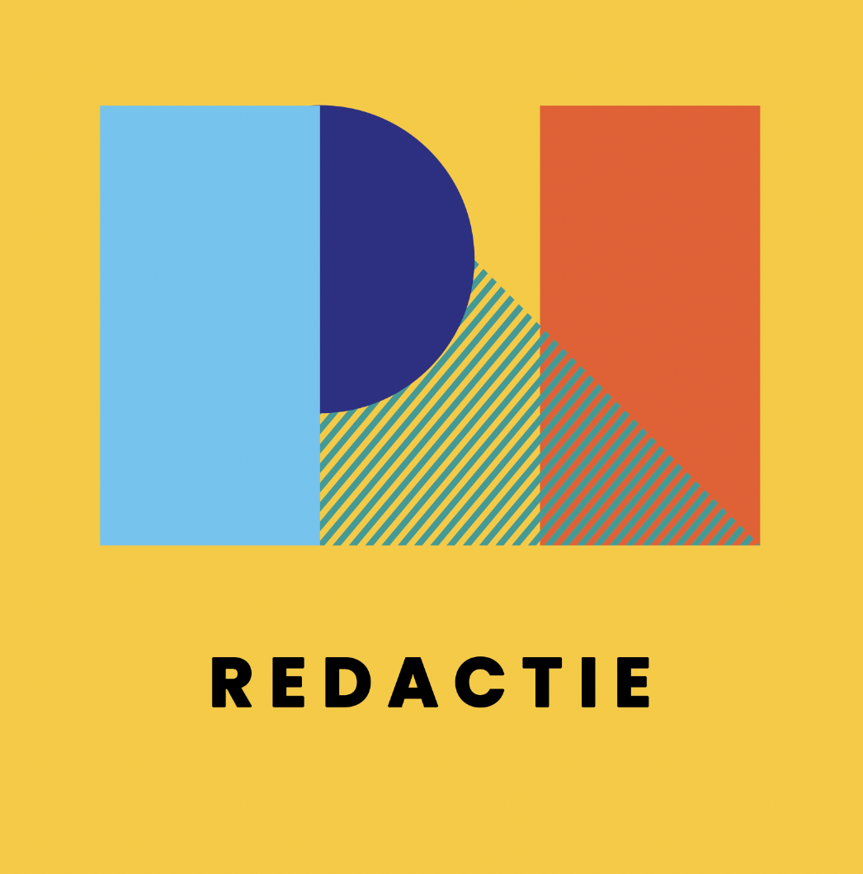



Editorials
Notes:
Publinova does three things: 1) We retrieve and combine information from backoffice repositories from institutions 2) We tell societal relevant stories of applied science 3) We promote and engage
Let' s dive into these three aspects

Slide 5


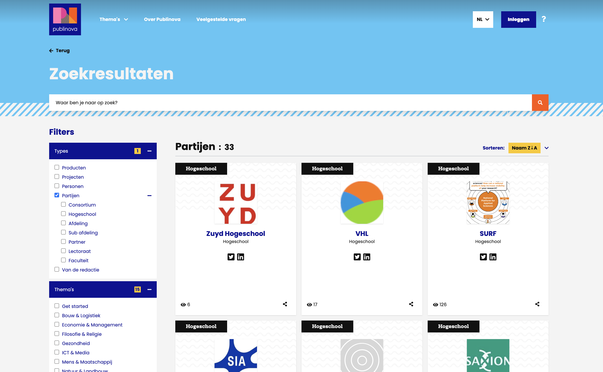

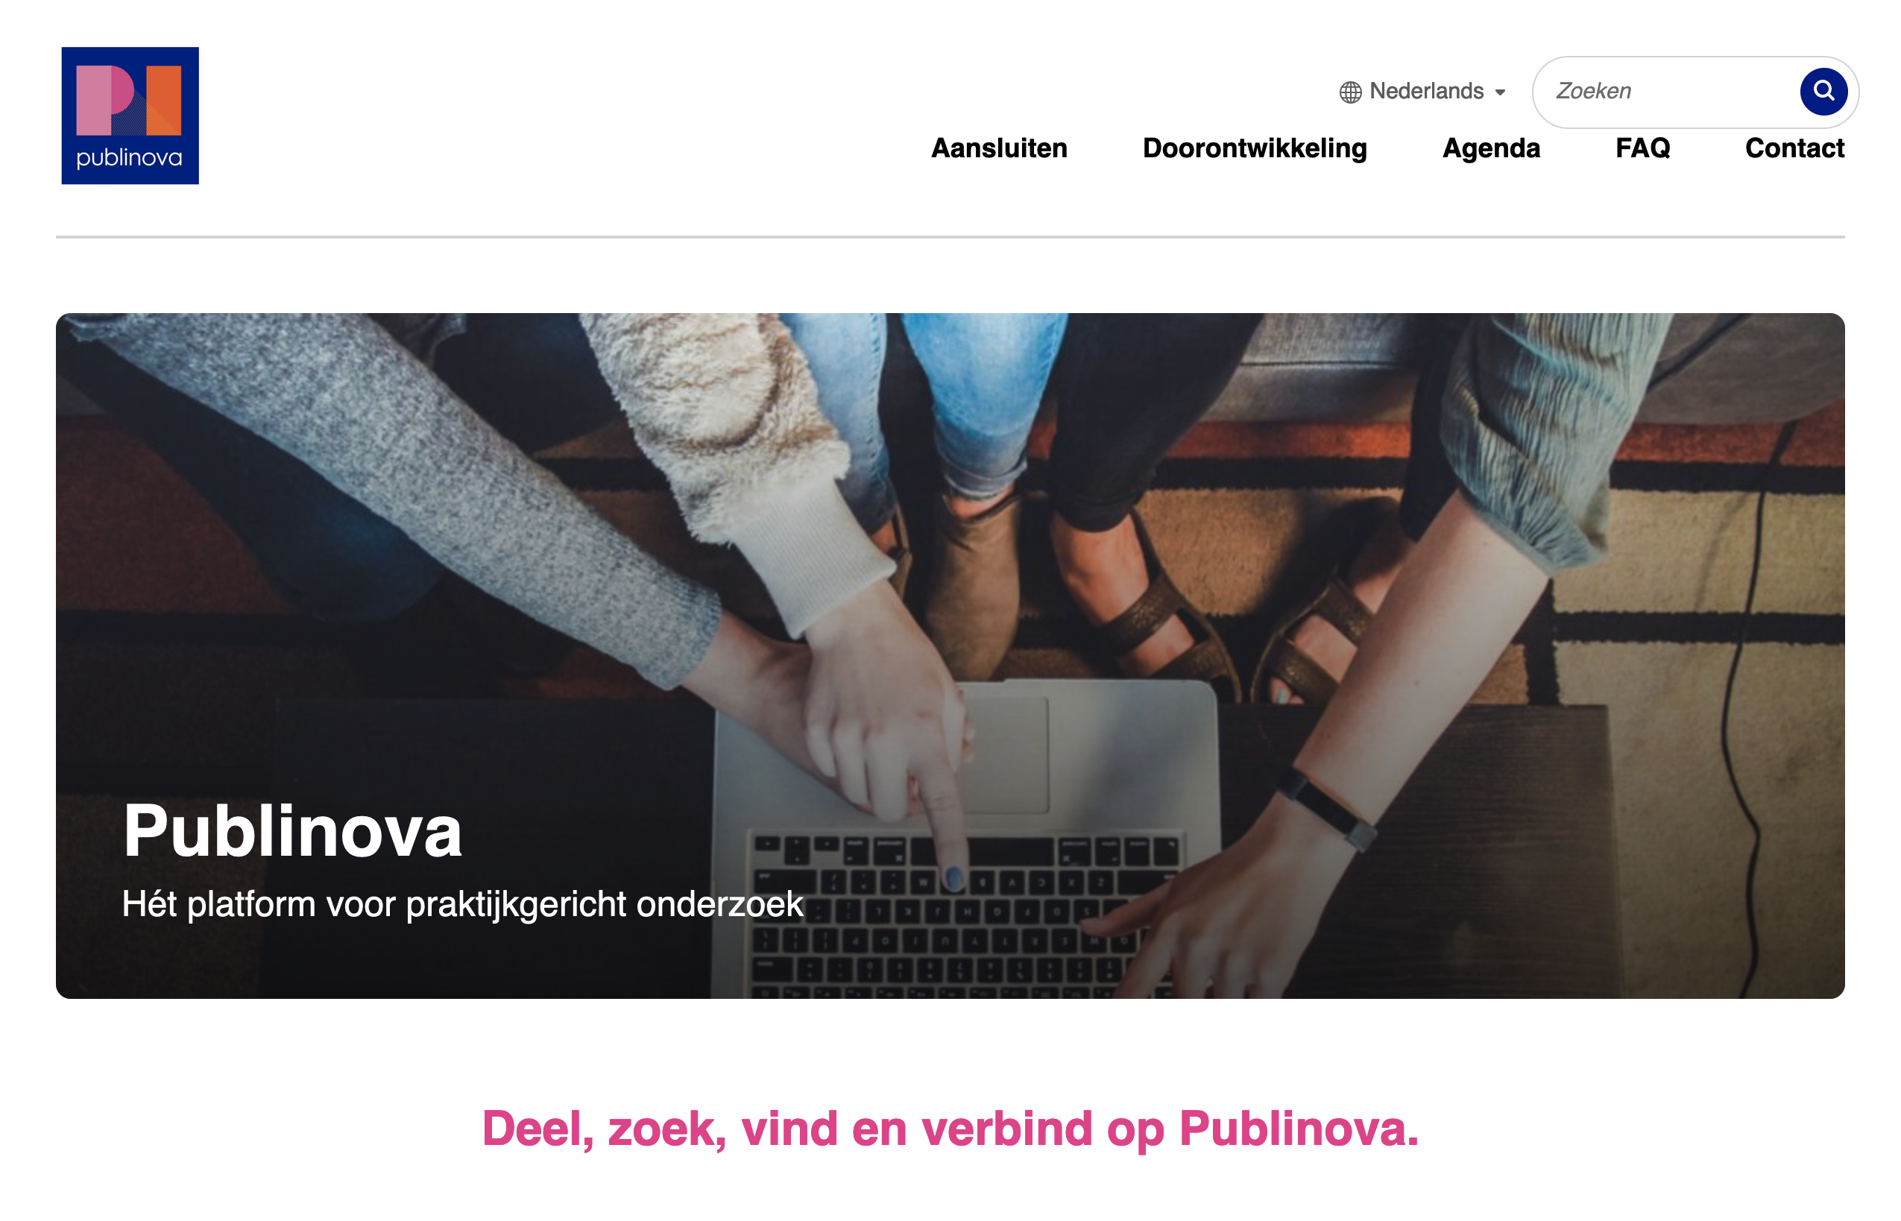
1. Create once, publish everywhere.
Repository systems
Harvesten
Relaties
Weergave
Partijen
Partijen
Personen
Personen
Personen
visitor / user
Projecten
Projecten
Projecten
Producten
Producten
Producten
Import
Configuratie
Configuratie
Redactioneel
Notes:
We retrieve open information from research information systems and project information systems. Create once, publish everywhere. Use the information that is already there.
We enrich this information with (meta)data for visual purposes and findability.
We just bring everything together and show you the results

Slide 6
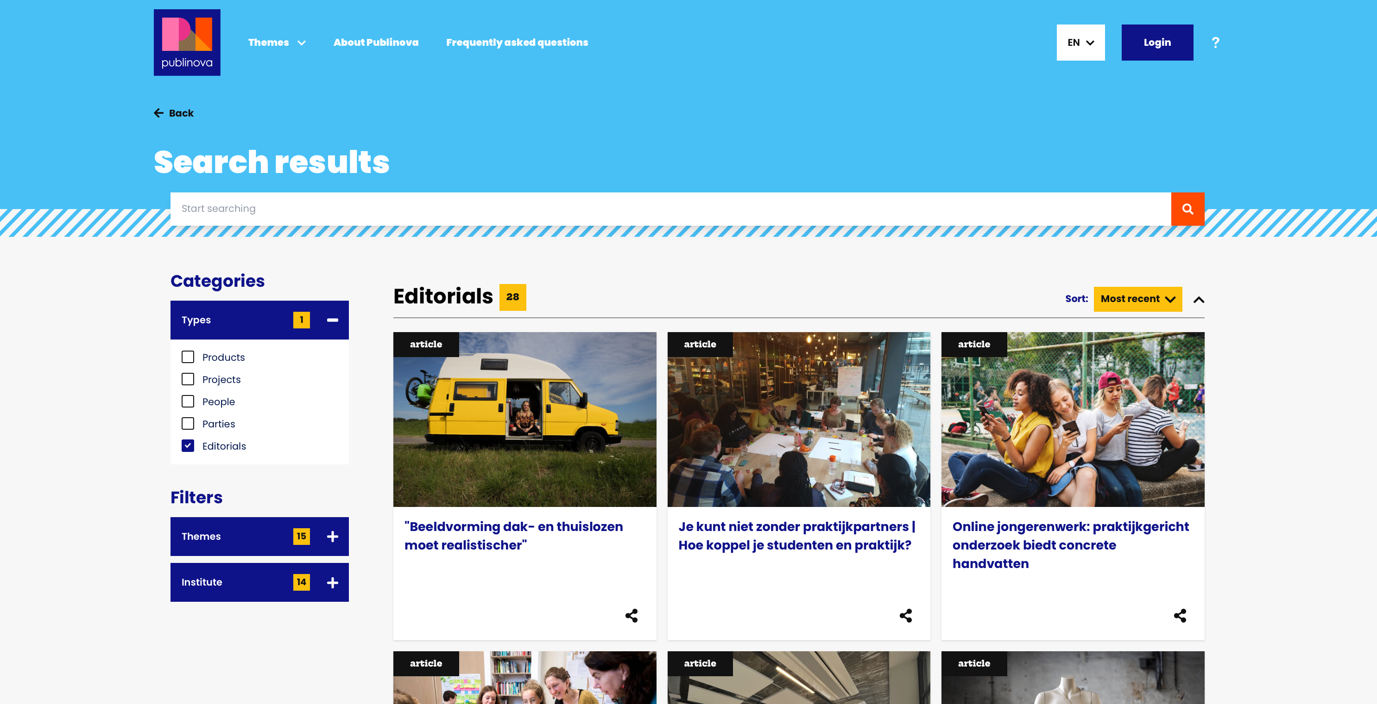

Slide 6
2 Tell stories of applied science
Notes:
2) To bridge the gap between the research output and societal issues, we tell stories of applied science.
Publinova uses themes to highlight societal relevant research through editorial content. Interdisciplenairy and national. No boundaries between organisations.

Slide 7
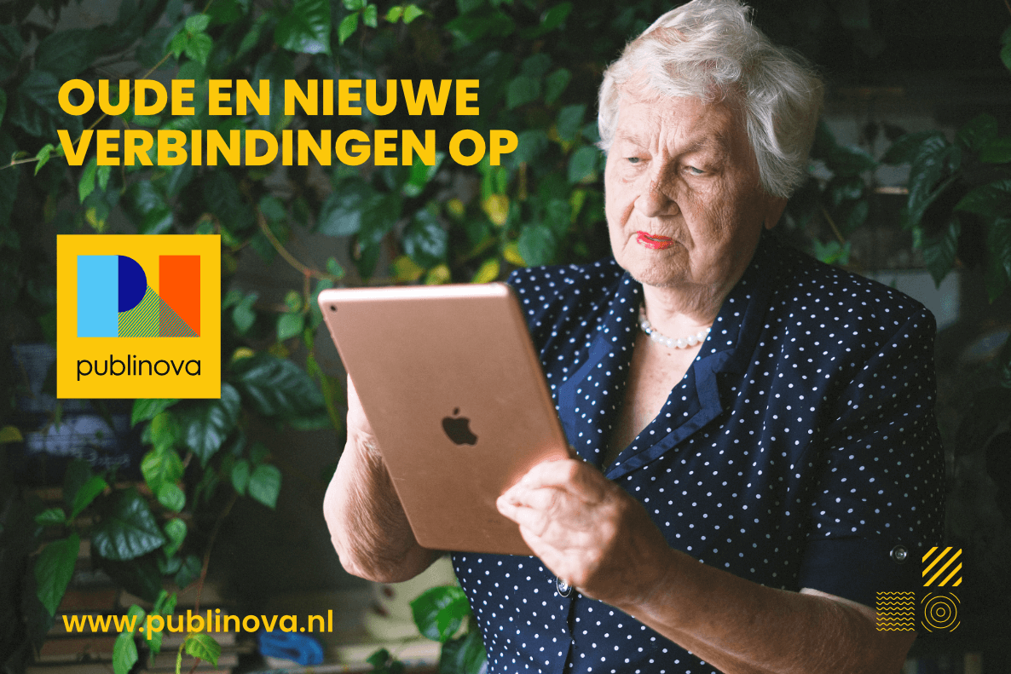
Slide 7
3 Connect and engage
Notes:
3) We connect, promote and engage. We use social media and other channels to create content and engage the Dutch applied research community. This is a joint effort between SIA, VH and the universities of applied sciences.

Slide 8
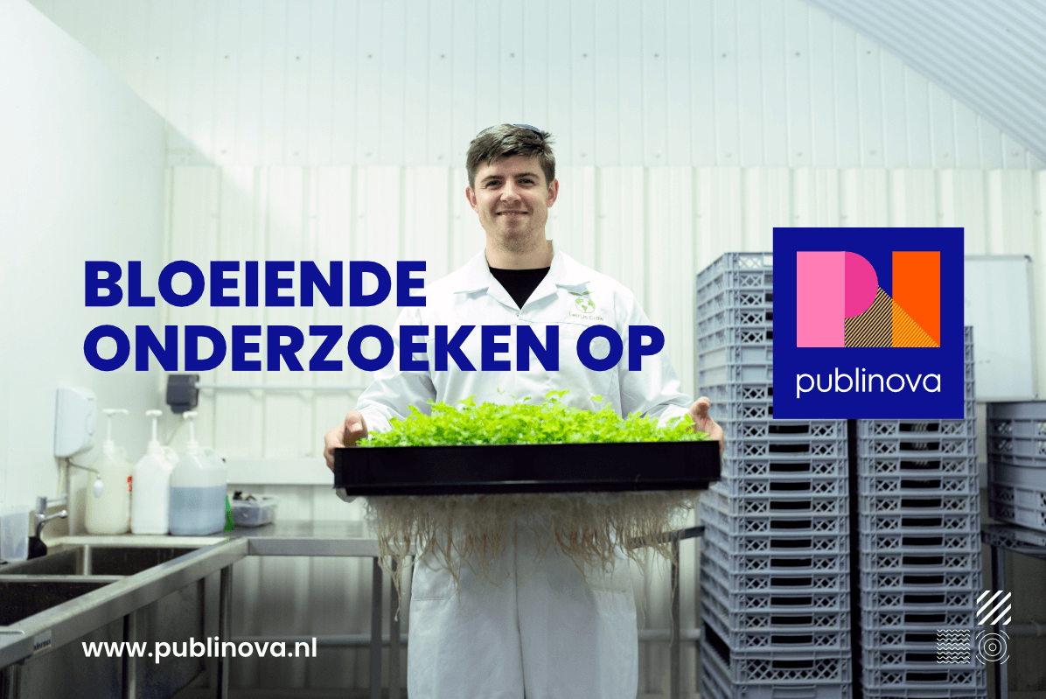
Slide 8
Notes:
We connect the library, communication and IT departments to make this vision possible. At the end together we are facilitating a shopping window for your research output. For people, for industry and for search engines.

Slide 9
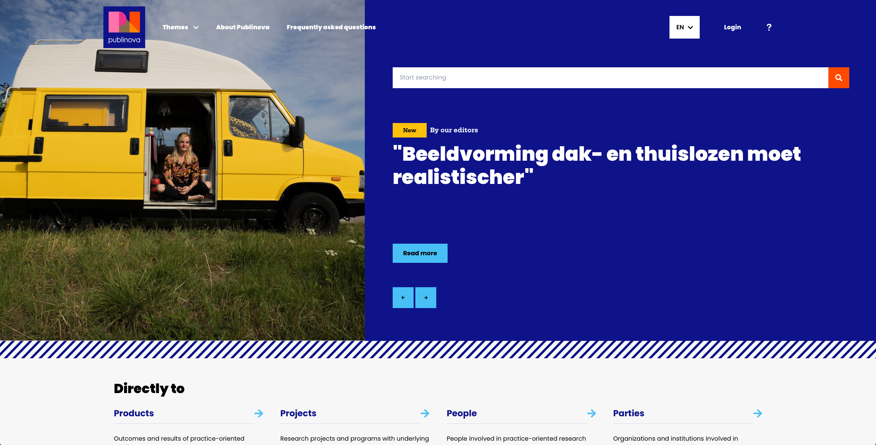
Slide 9
Notes:
This is the homepage of Publinova. With a prominent place for search and editorial content. To search for researchers, the projects they're in, the products they produce and the organisations they work with. Every week, we publish a new piece of content on our website and our social media platforms.

Slide 10
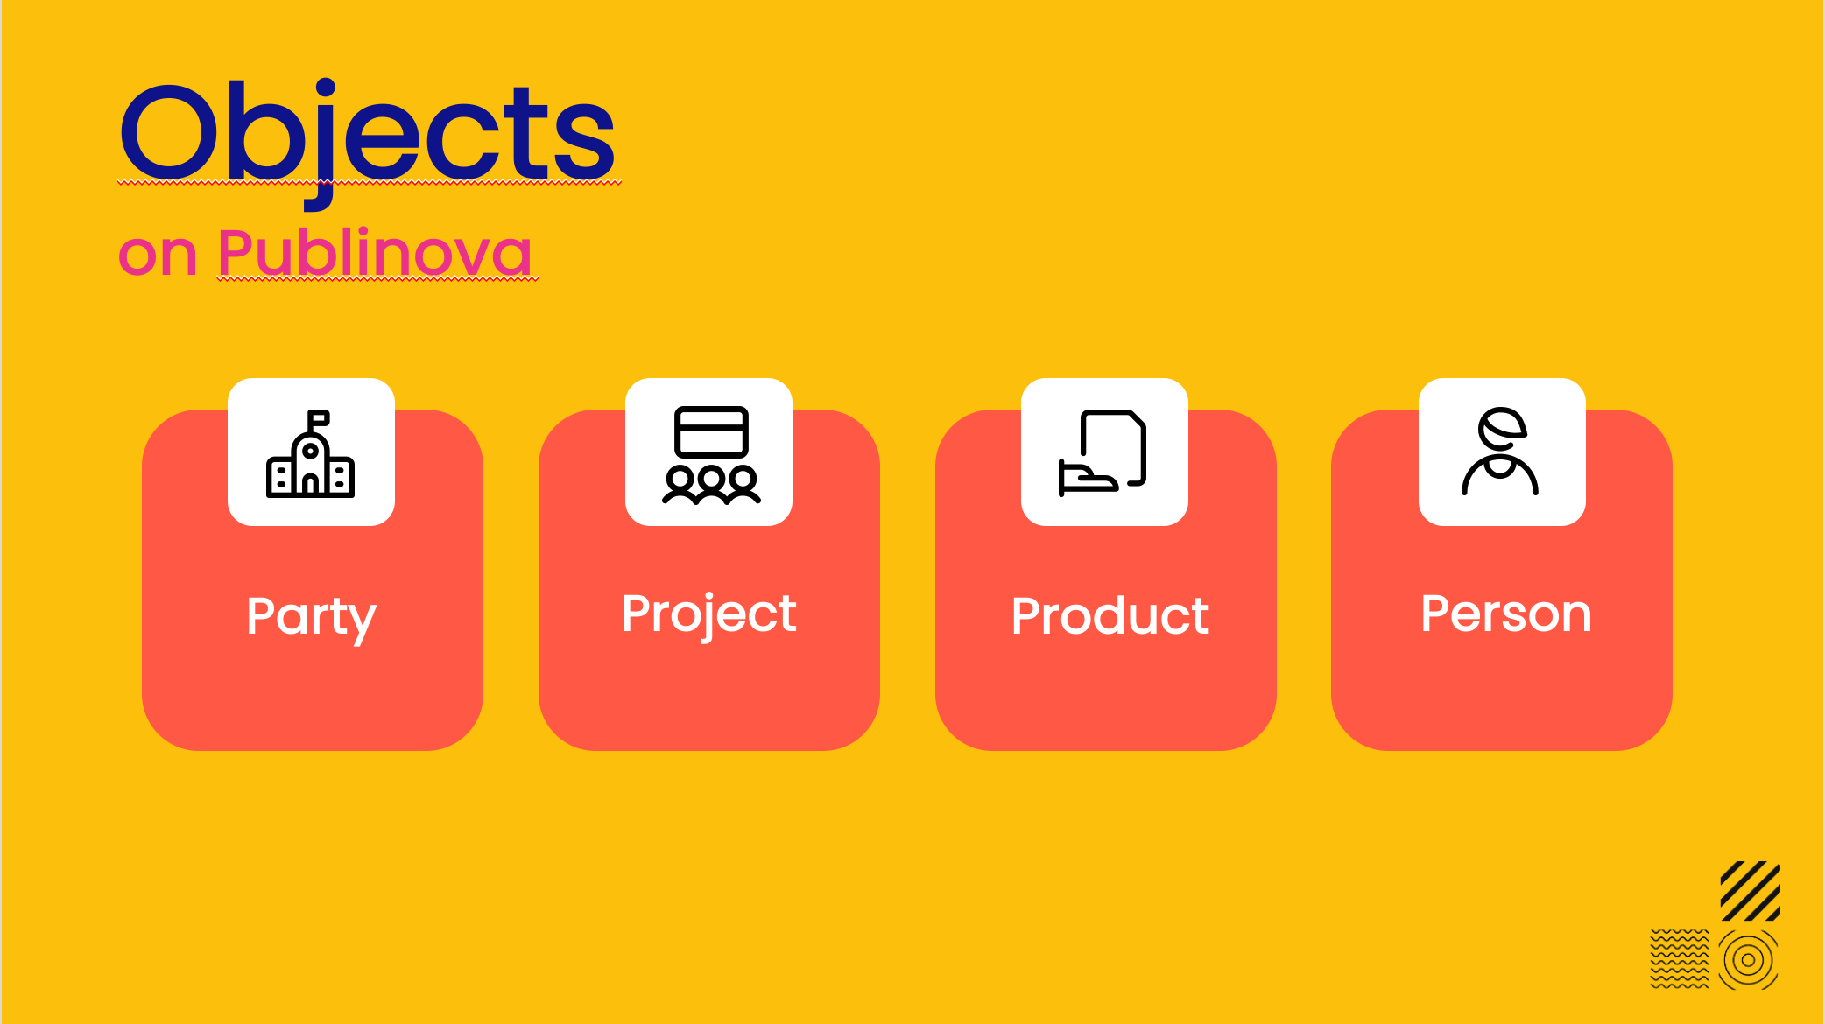
Slide 10
Notes:
Applied research is all about research products and societal relevance.
Therefore: prominent on the website: The four P's: Party, Project, Product and people. And we link all P' s to every other P on Publinova

Slide 11

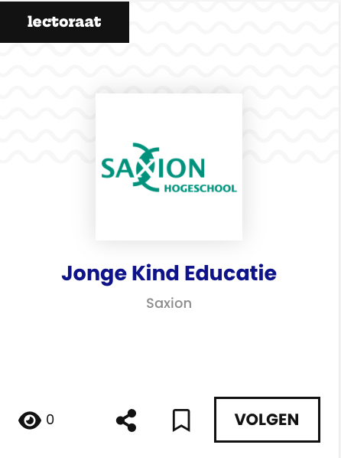
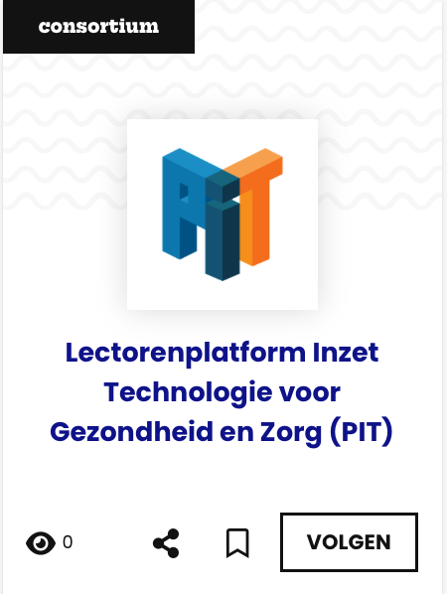

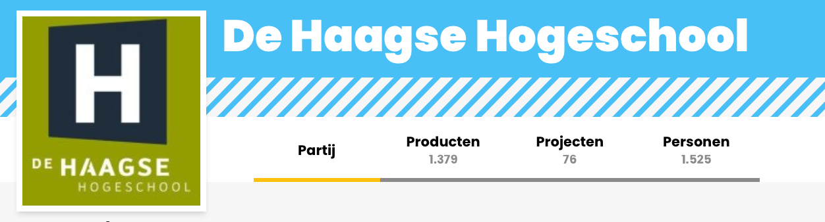

Slide 14
Notes:
'Parties' is every organisation involved in applied research. Universities of applied sciences, industry, societal organisations, Centres of Expertise, SPRONG groups, and so on and so forth.

Slide 12
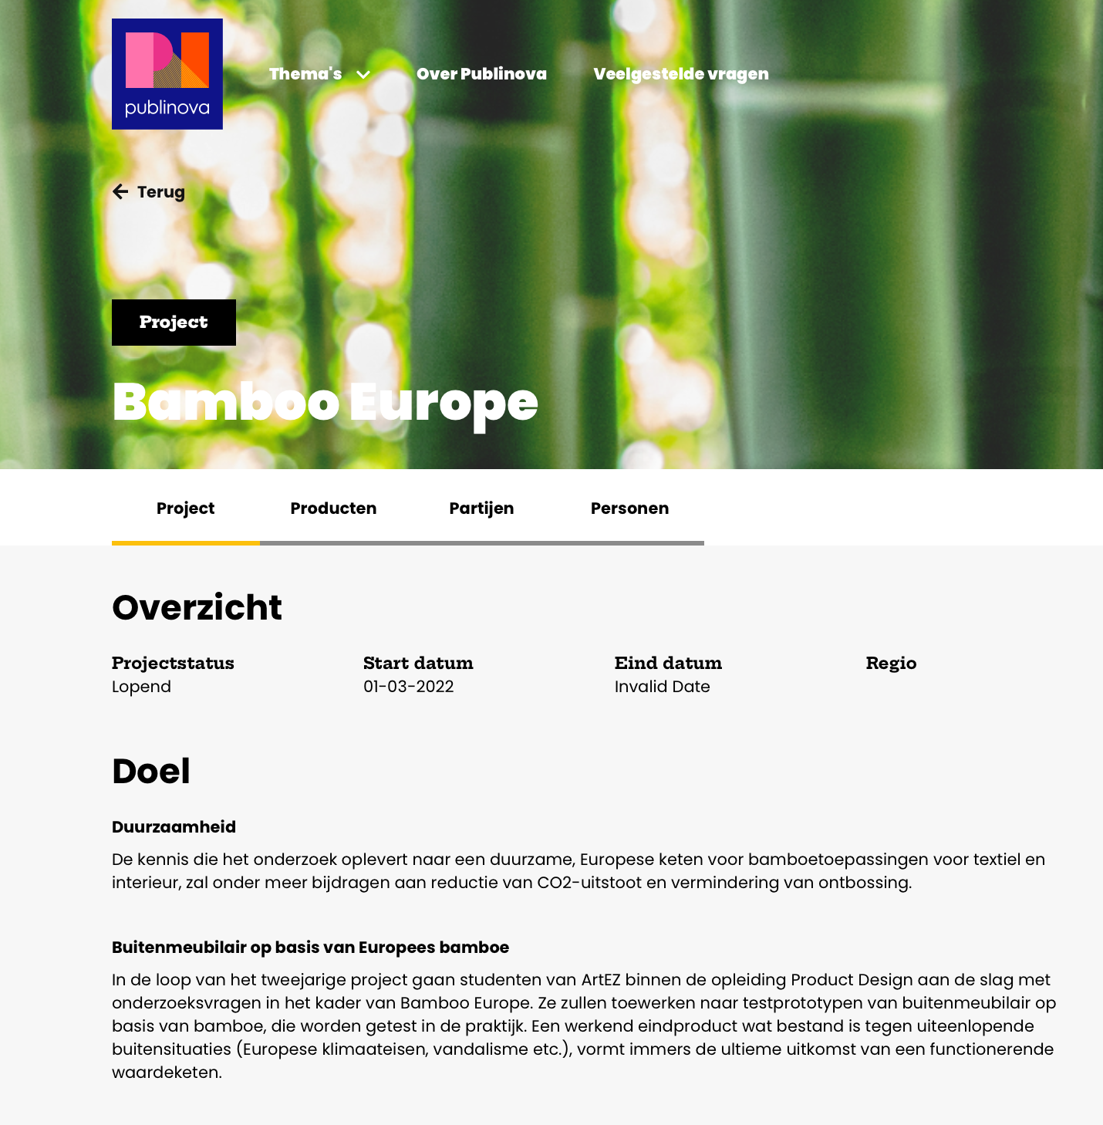
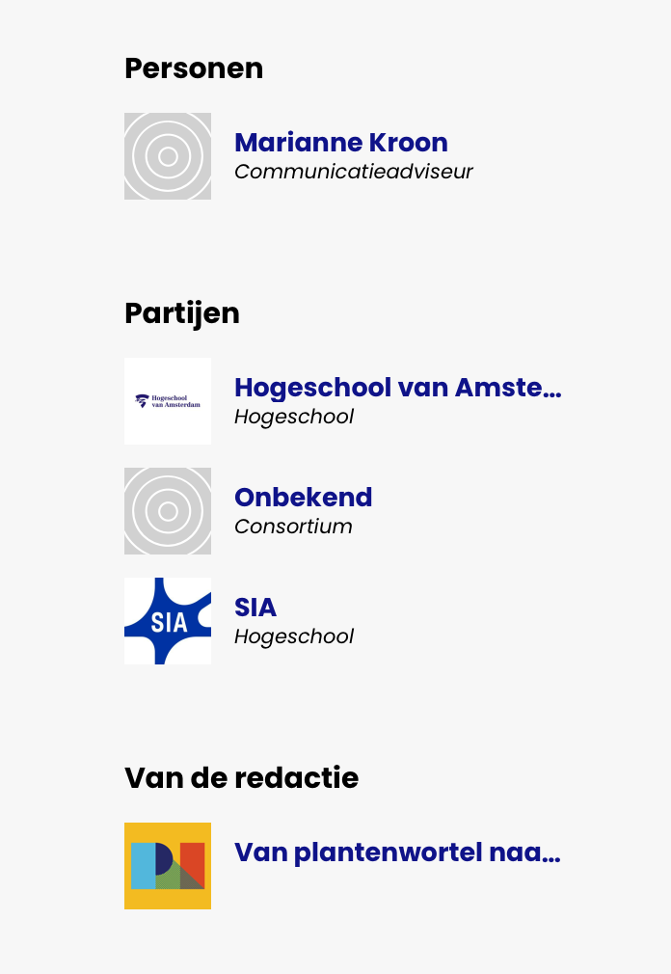
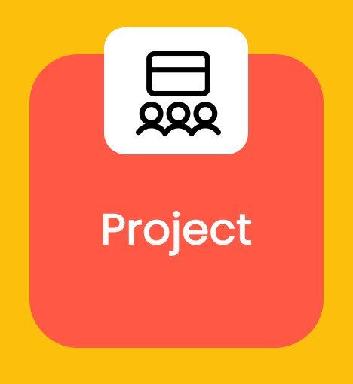
Slide 12
Notes:
'Projects' have a start and end date....but remain visible on Publinova when they have finished. This way, research output remains available for future opportunities. As you can see in this project you see the involved parties and an editorial content written about this subject.

Slide 13







Slide 11
Notes:
'Products’ in applied science can have multiple forms. Publications, applications, audio, images, presentations, spreadsheets, videos and websites. Just name it and it's there. Publinova is not restrained to the traditional publication form.

Slide 14
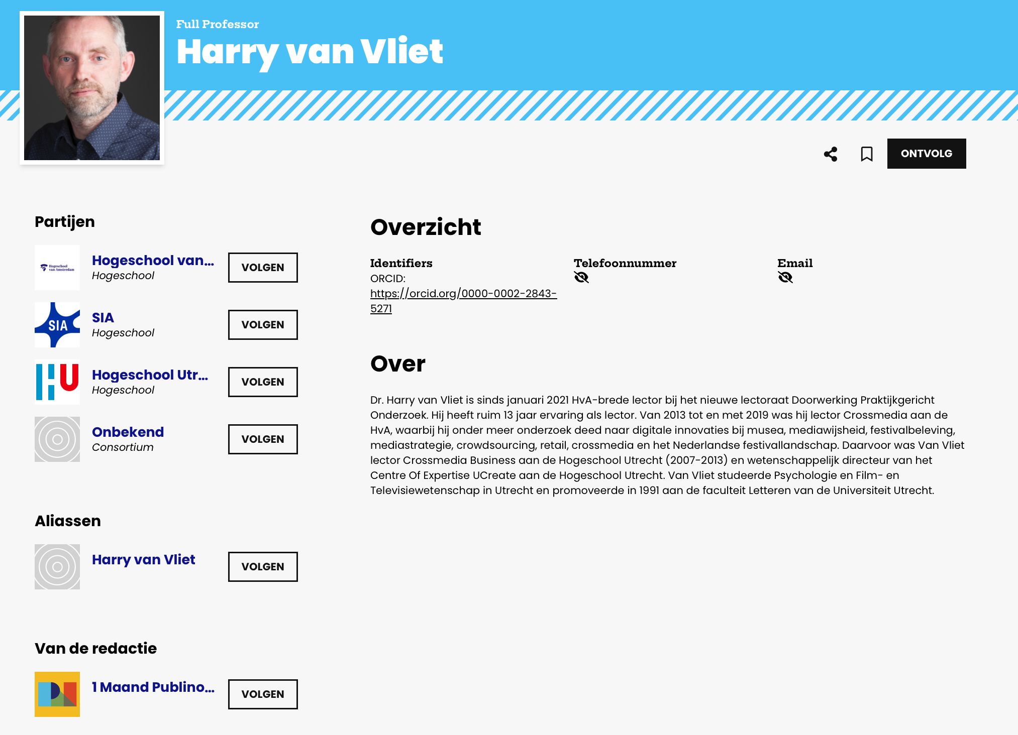
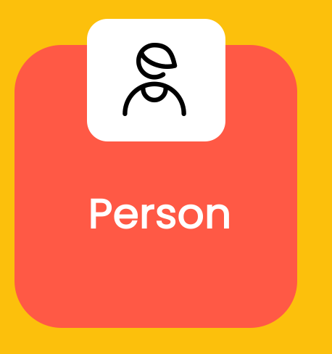


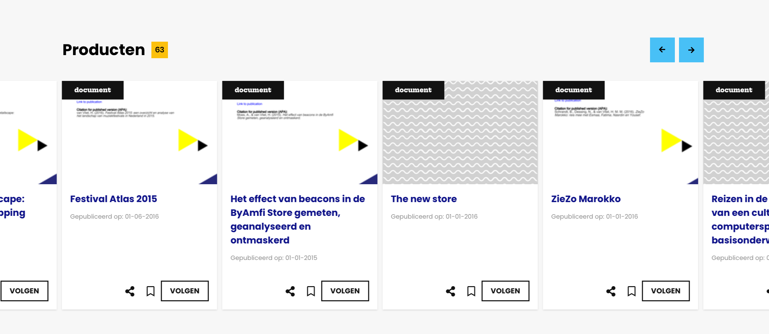
Slide 13
Notes:
'Person' is a researcher. If there is an identifier used such as ORCID we connect all the research automatically. No matter if you are working on one, two or three projects across different universities of applied science. The researcher will be in charge of the content on the profile.

Slide 15
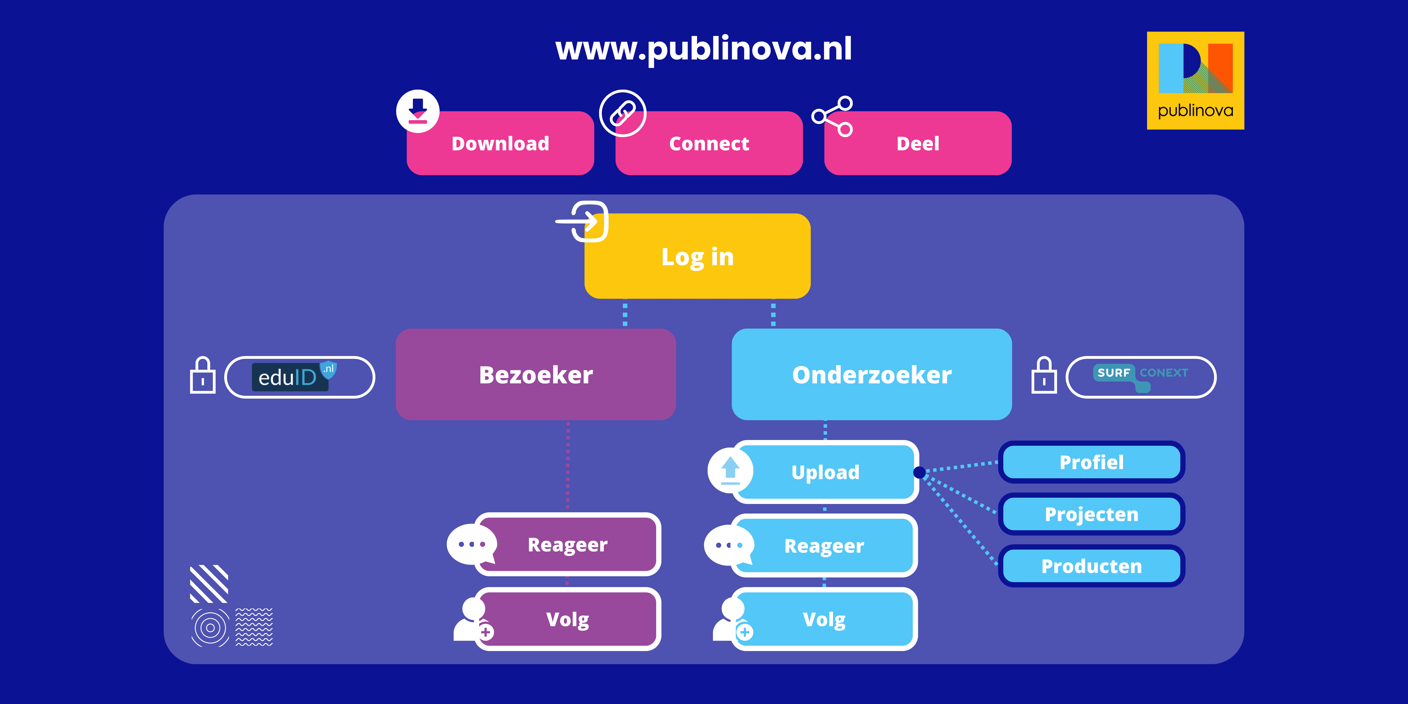
Slide 13
Notes:
Every user without log in can download, connect and share. When you log in you can follow, save and comment. When you are a researcher you can profile yourself and enrich your profile and add content.

Slide 16

Slide 15
Notes:
And every piece of information is connected to every other piece, by us and by you. This means: Projects to products. Products to people, people to parties and everything to editorial content. To inspire, to connect, to promote and to engage.

Slide 17
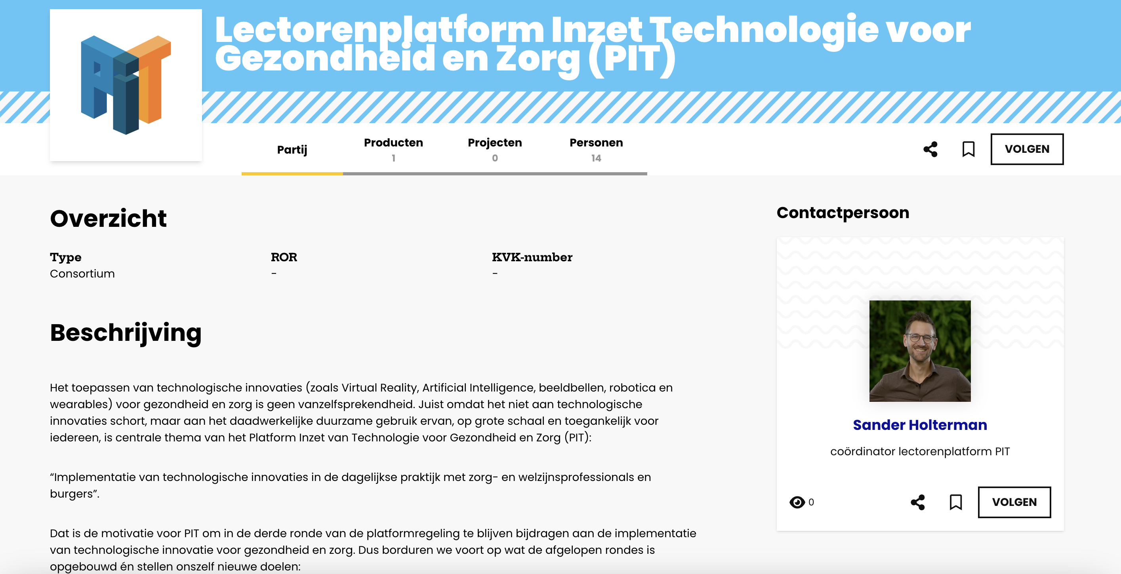
Slide 13
Notes:
And because we have all this information, we can create a place for collaborations like a lectorate platform. Or any other cross section. Again, linking this to the 4 P's. No extra information needed, No extra investment needed. A ready made communication and promotion platform for you to use.

Slide 18


























Slide 16
The numbers
9
Already connected
4
In preparation
12
Are interested
Notes:
We have only just started. The ambitions are high, but the path is challenging. For Publinova to reach its potential the institutes need to have their research information on point. Together we are exploring the challenging path towards open applied research information.

Slide 19
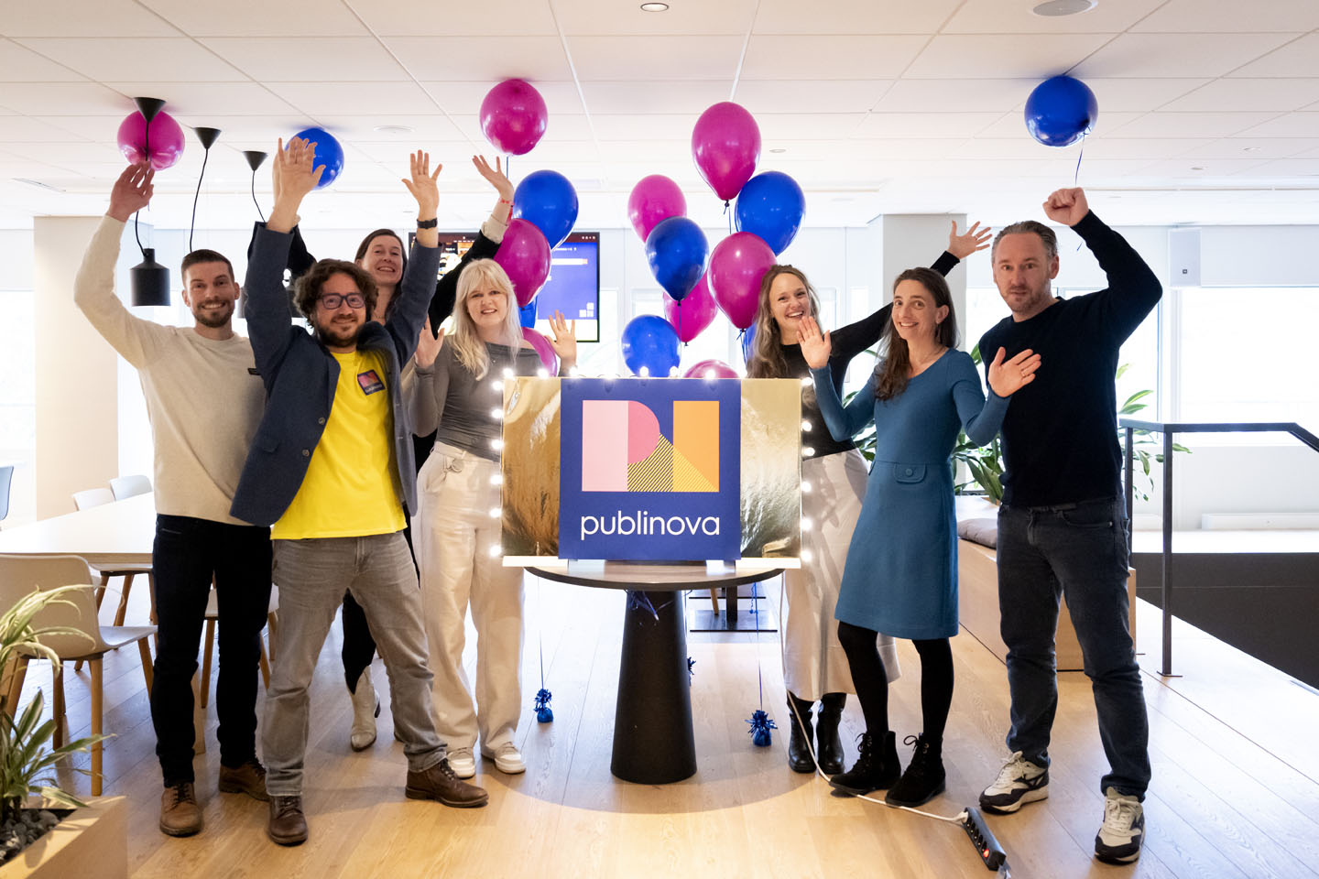
Slide 17
Notes:
Join us now to start creating impact with your research. Go to your library / data steward / publication specialist / open access specialist for more information or ask us. We will connect you to the right person in your institution.

Slide 20

Slide 20
Notes:
Are you as excited as we are about the possibilities of Publinova for your research and your institution? Visit our stand for a chat, a demo and chocolate. You can find us on LinkedIn, Mastodon. My name is Rob Speekenbrink, community manager at Publinova.

